Slide 1


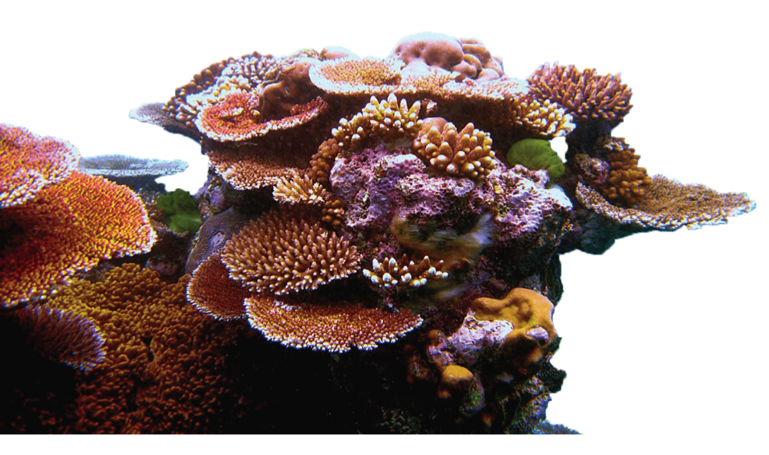
Research Proposal
2021.10.8
Yafei Mao

Slide 2





Self-introduction
Education:
Okinawa Institute of Science and Technology Graduate University
Ph.D., Evolutionary Genomics
(Advisors: Dr. Noriyuki Satoh and Dr. Evan Economo)
Nanjing University
B.Sc. , Life Sciences
Professional Experience:
University of Washington
Postdoctoral Fellow (Advisor: Dr. Evan Eichler)
Princeton University
Visiting student (Advisor: Dr. Ricardo Mallarino)
Hong Kong University of Science and Technology
Visiting student (Advisor: Dr. Mingjie Zhang)
Japan
Sep 2014 - Apr 2019
China
Sep 2010 - Jun 2014
Seattle, USA
June 2019 – Present
Princeton, USA
May 2018 - Oct 2018
Hongkong, China
Oct 2013 - Mar 2014

Slide 3
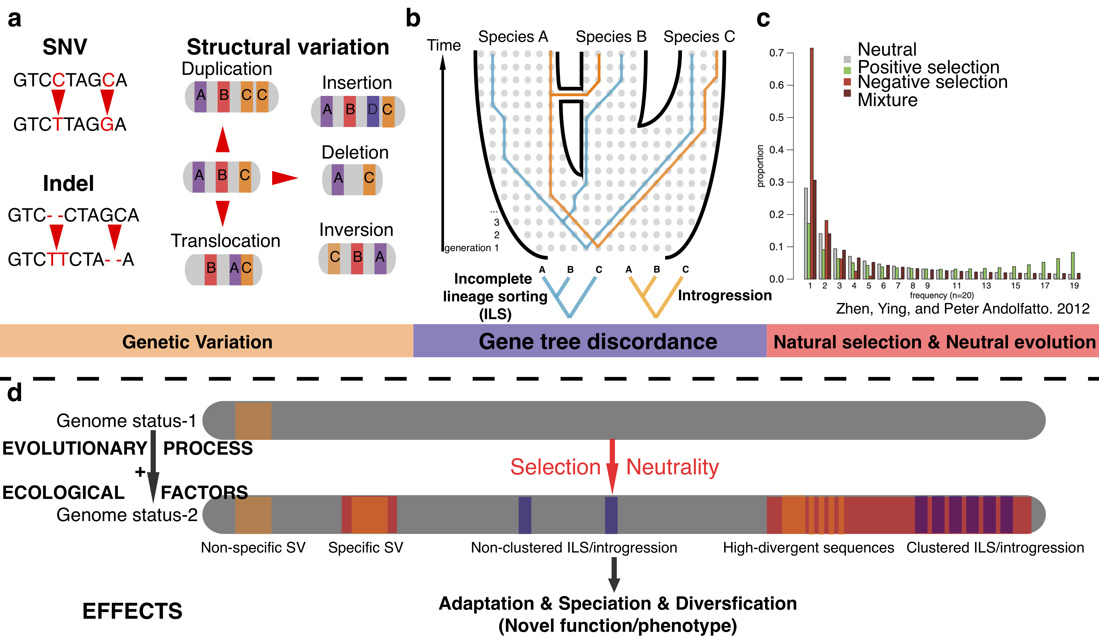
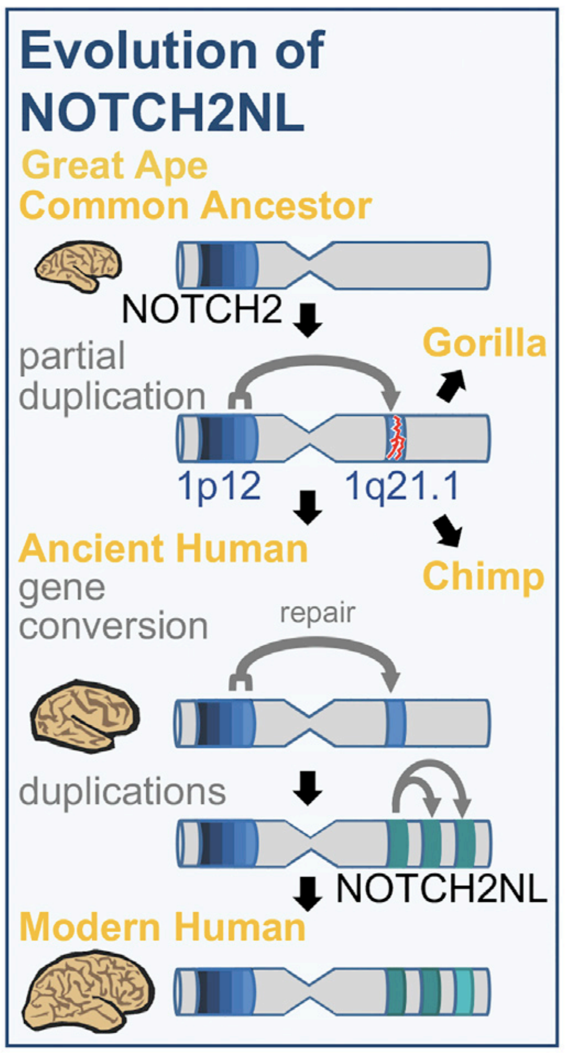
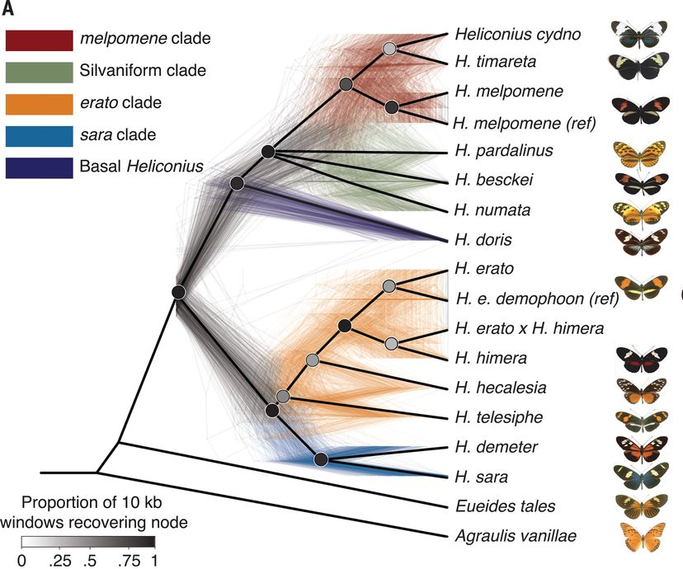
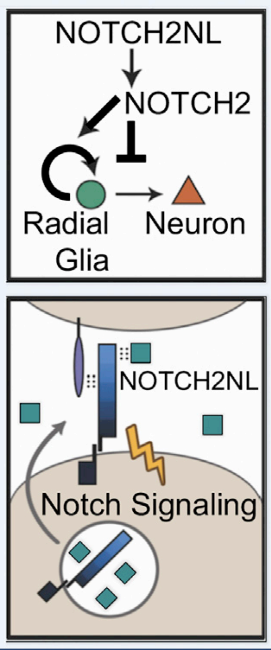
The importance of structure variation and introgression in evolution
diverse patterns across
organism groups
shaped in genome architecture
Duplication affects brain evolution
Adaptive introgression
SV
Introgression
not adequately investigated in non-model organisms because of short-read technologies
Human
specific
duplication
Fiddes, I. T., et.al, Cell. Edelman, Nathaniel B., et al. Science (2019)

Slide 4
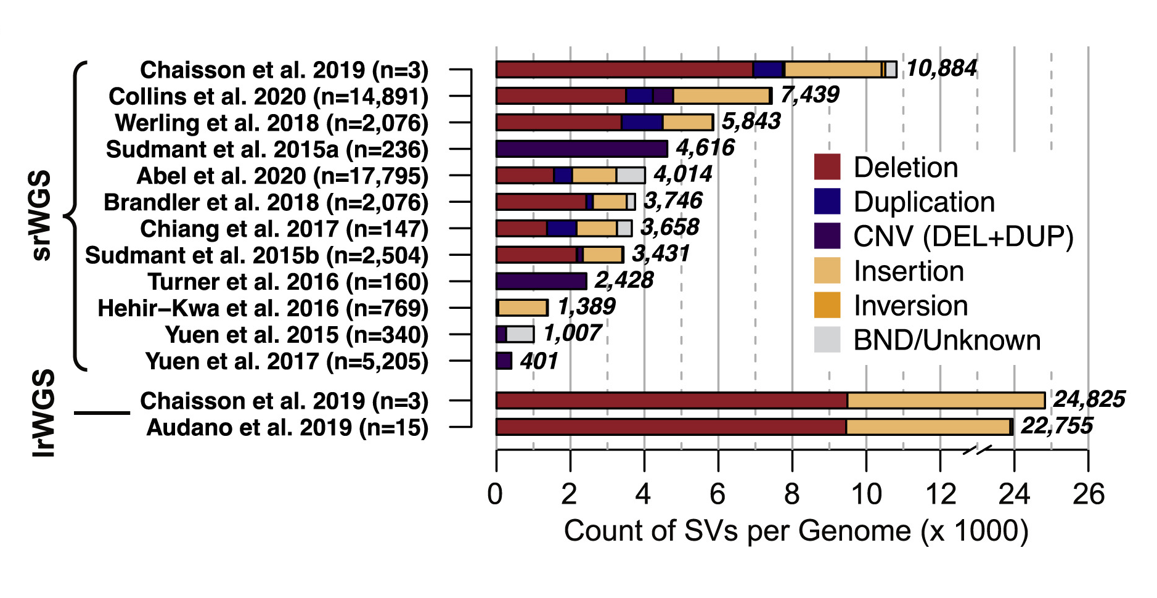
The merit of long read technologies
More continuous genomes
PacBio HiFi
Oxford ONT
The greater number of SVs
better understand SVs and introgression in genome evolution
~ 70% SVs were missed in short-read datasets
Zhao, X.,el al.. AJHG (2021).; Kronenberg, et al. Science (2018).

Slide 5
Research questions
(1). What is genome landscape of SVs and introgressed loci?
(2). How do SVs and introgressed loci driven by natural selection lead to adaptation, speciation, and divergence?

Slide 6
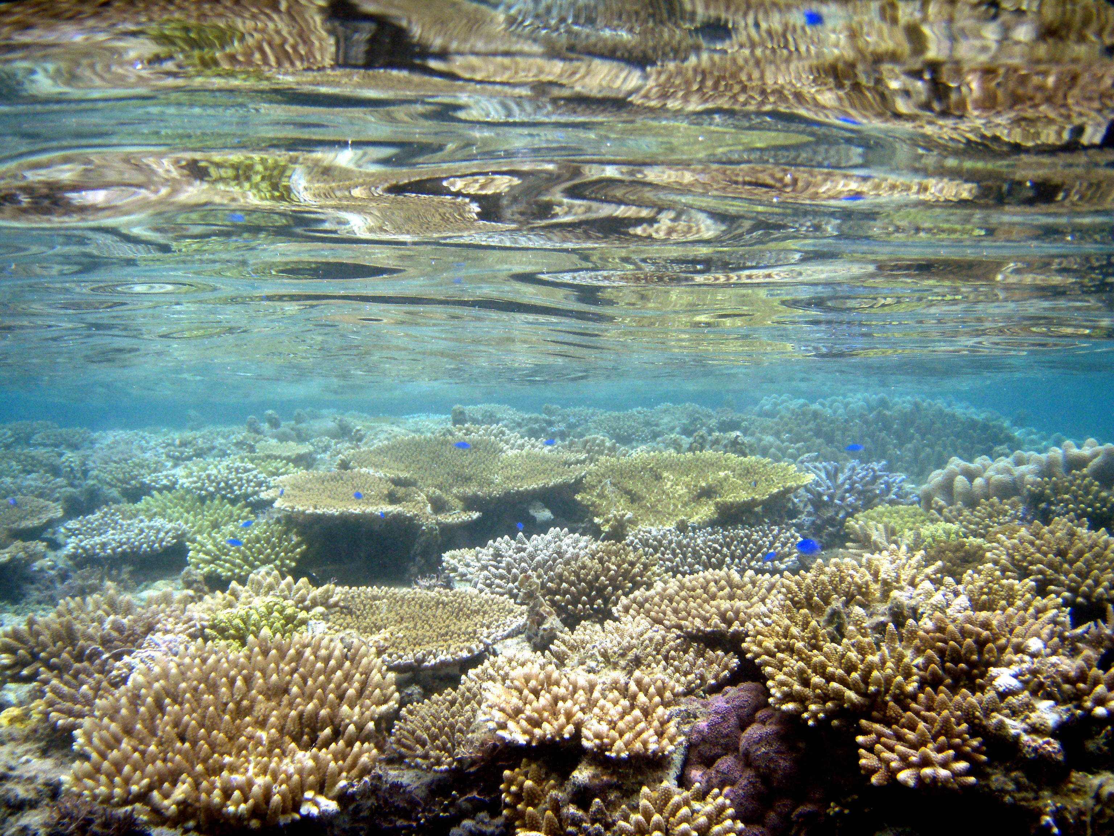
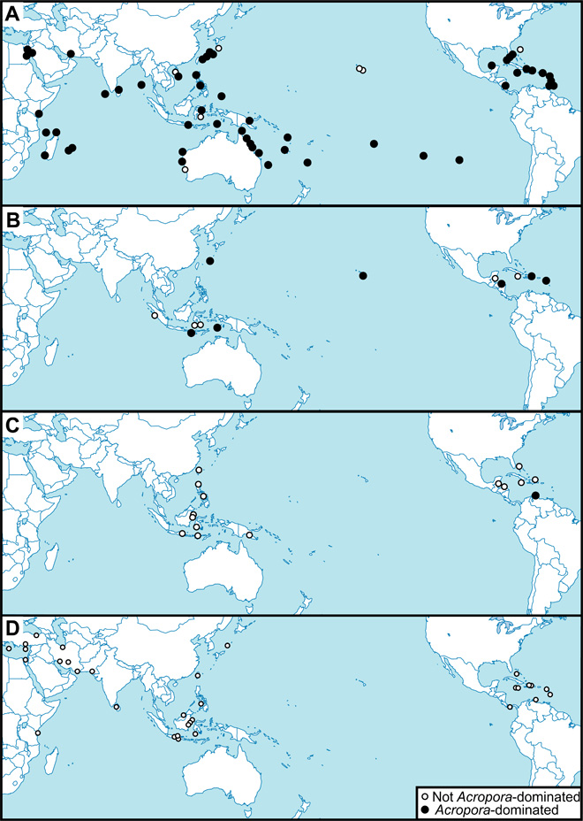
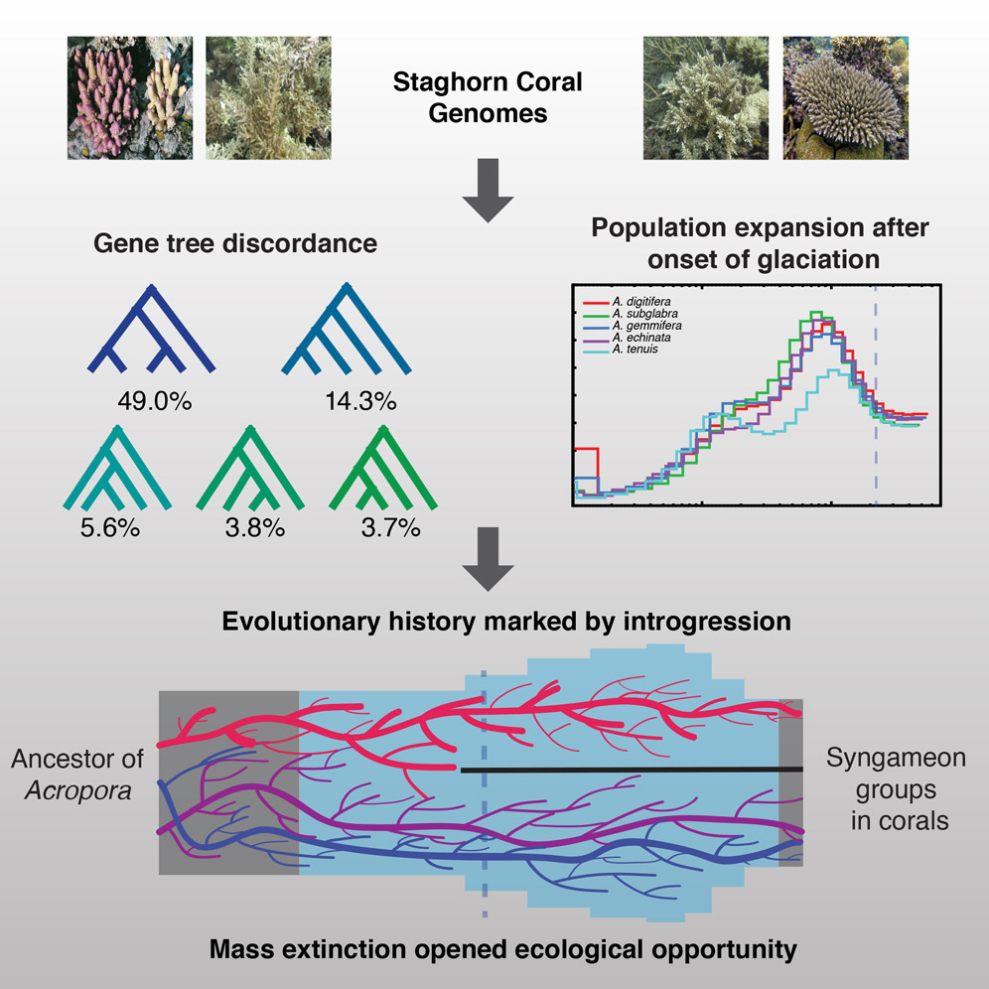
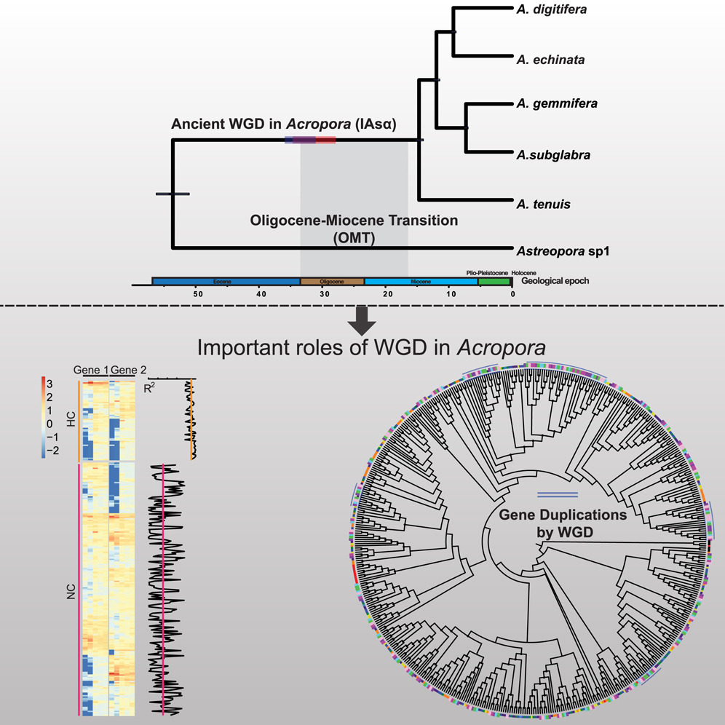
Coral reefs: a good model system
Acropora (~150 species)
fossil record map
Diversified & Dominant
adaptive introgression
burst of duplication
supporting ~30% marine organisms
diversity is dramatically declining
unsolved questions:
genome-wide introgressed & duplicated loci?
adaptive introgressed & duplicated loci?
origins and diversification of Acropora?
Mao et al., Current Biology (2018)
Mao et al., Mol Ecol Resour (2020)
Mao et al., Iscience (2019)
duplication and introgression in Acropora
Dubinsky, Zvy, and Noga Stambler. Springer Science & Business Media, 2010.

Slide 7
A five year research project
Aim 1.
Aim 2.
Aim 3.
Build a telomere-to-telomere (T2T) genome assembly of Acropora and investigate introgressed and duplicated loci
Reconstruct the phylogeographic history of Acropora
Characterize functional genetic loci in association with adaptation to climate change
Timeline
0
1
2
3
4
5 year
Aim 1
Aim 2
Aim 3
Potential Funding:
(1) National Natural Science Foundation of China:
for Excellent Young Scholars
(2) Research Grants Council (RGC): GRF Grant

Slide 8
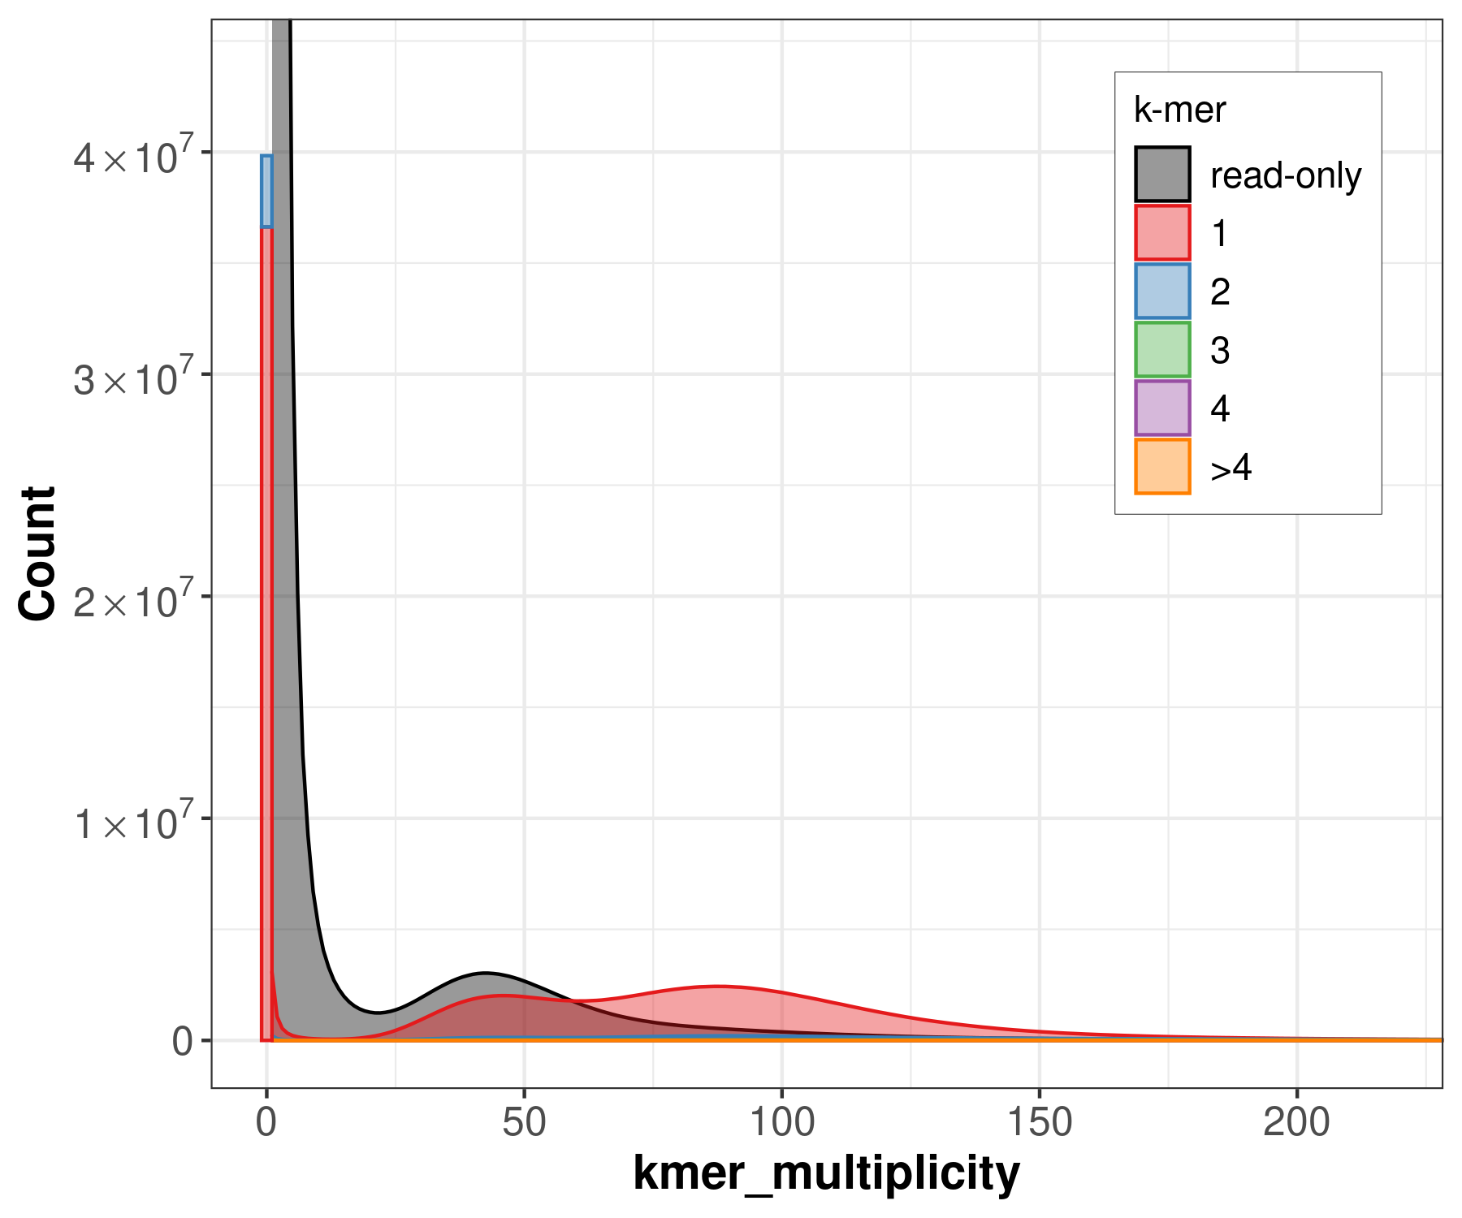
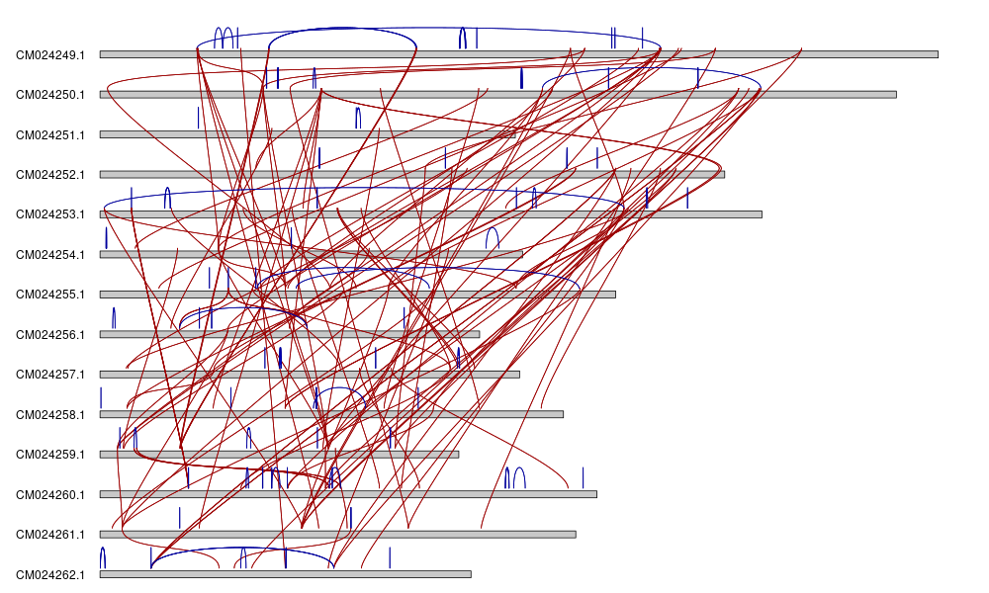
A complete and error-free genome of Acropora
1-1. Building a T2T genome assembly of Acropora (~400 Mbp)
Preliminary data:
1. Low accuracy in the previous genome assembly of Acropora (QV=23.8, incorrectly sequenced sites: 1.6 Mbp (0.4%))
2. Large proportion of segmental duplications in the assembly (incorrectly assembled regions: 40 Mbp (~10%))
sequencing error
duplicated regions
Aim 1
Fuller, Z. L., et.al, 2020, Science.

Slide 9
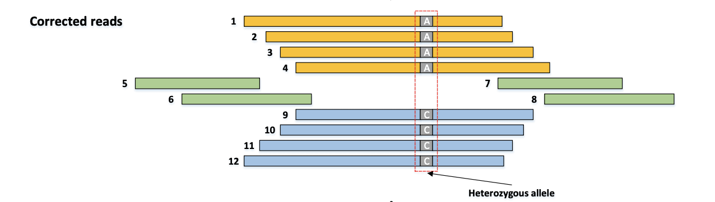
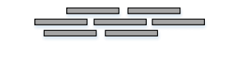
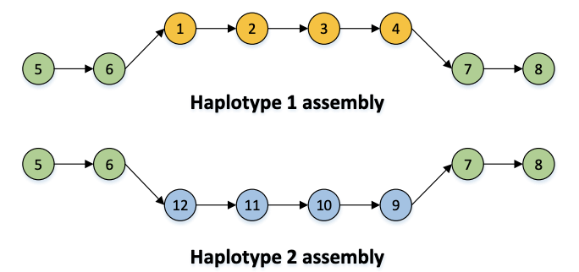
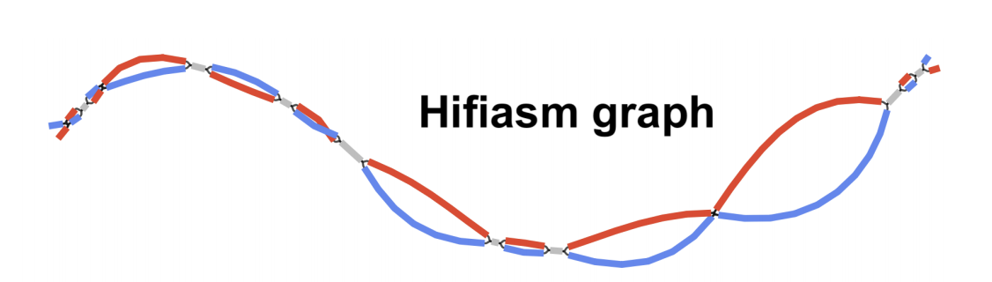
A complete and error-free genome of Acropora
1-1. Build a T2T genome assembly of Acropora
Hi-C reads
HiFi reads (50X)
hifiasm
UL-long ONT reads (100X)
Haplotype-resolved contigs
In-house pipeline
validation (comp. & expe.)
&
downstream analyses
A complete and error-free genome
Aim 1

Slide 10
Introgressed and duplicated locus maps
1-2. Construct introgressed & duplicated region maps
Hypothesis: introgressed & duplicated loci are highly associated with adaptation to climate change
Methods:
T2T assembly
10 Acropora
+3 outgroup (30X)
read mapping &
whole-genome
comparison
duplicated regions
(WSSD & WGAC)
introgressed regions
(f4 statistics & S* )
Validation: FISH
duplicated
introgressed
Acropora-specific
species-level
functional analyses (Aim 3)
Aim 1

Slide 11
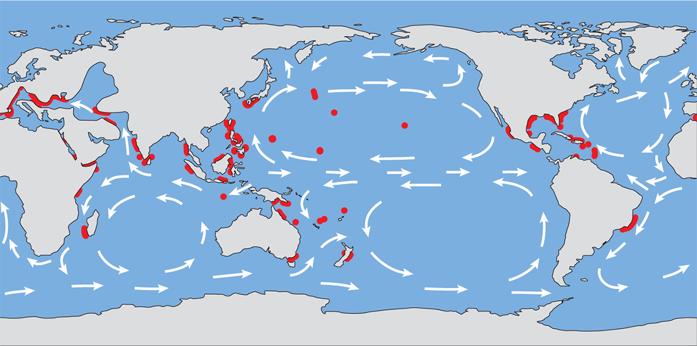
Phylogeographic history of Acropora
Aim 2. Reconstruct the phylogeographic history of Acropora
Hypotheses:
1. population-specific duplication and introgression
2. modern Acropora origin from Caribbean corals after
closure of Isthmus of Panama
3. divergence of Acropora or gene flow between
populations associated with ecological factors
H1:
Methods:
population structure (PCA & STRUCTURE)
gene flow between populations
(f4 statistics & TreeMix )
Sampling > 500 specimens
&
re-sequencing (3X)
H2 & H3:
phylogeny & time-tree (IQ-TREE & BEAST2)
diversification rate estimate (BAMM)
modeling (collaboration with OIST)
ecological data
(location, temperature, …)
Aim 2
Renema, Willem, et al. (2016)

Slide 12
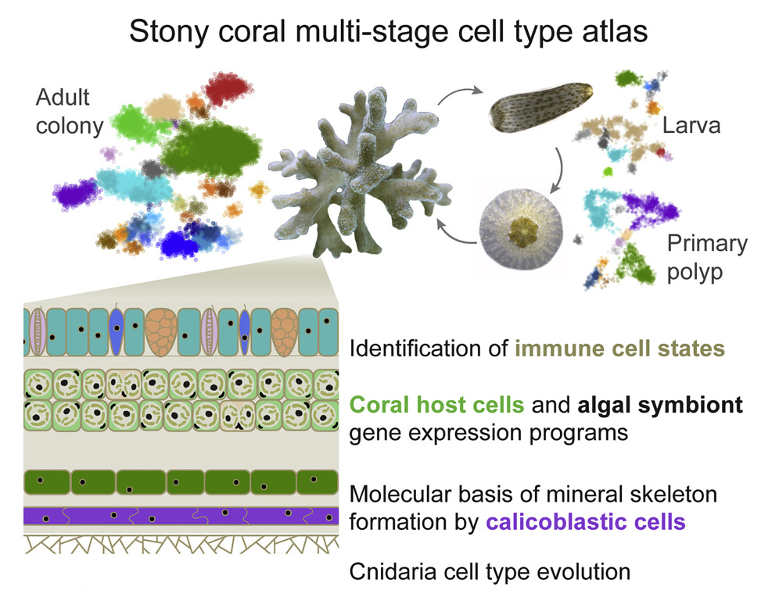
Functional assessments with single-cell sequencing
Aim 3. Characterize functional genetic loci associated with adaptation to climate change
Hypothesis: Acropora (population)-specific duplicated & introgressed loci in association with symbiosis, calcification, and immunity
calcification
algal symbionts
immunity
adaptation to climate change
Levy, S., Elek, A. et al, (2021). Cell
Aim 3

Slide 13
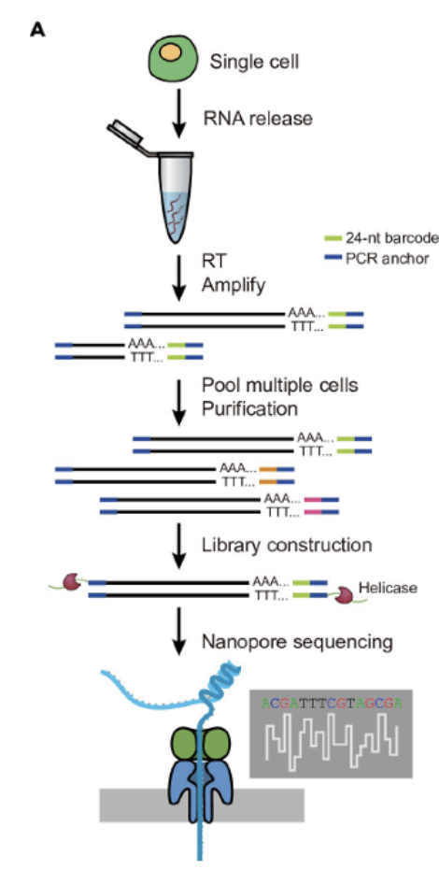
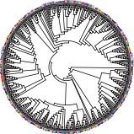
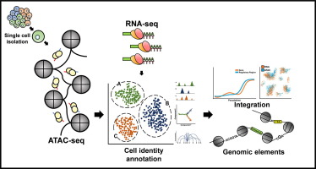
Functional assessments with single-cell sequencing
Aim 3. Characterize functional genetic loci associated with adaptation to climate change
Single-cell long-reads RNA
Aim 1
duplicated
introgressed
Aim 2
Acropora
(population)
-specific loci
ATAC-seq (gene regulation)
Are the loci associated with symbiosis, calcification, and immunity?
1. gene structure changes (coding)
2. gene regulation changes (noncoding)
SCAN-seq (gene expression)
Aim 3

Slide 14
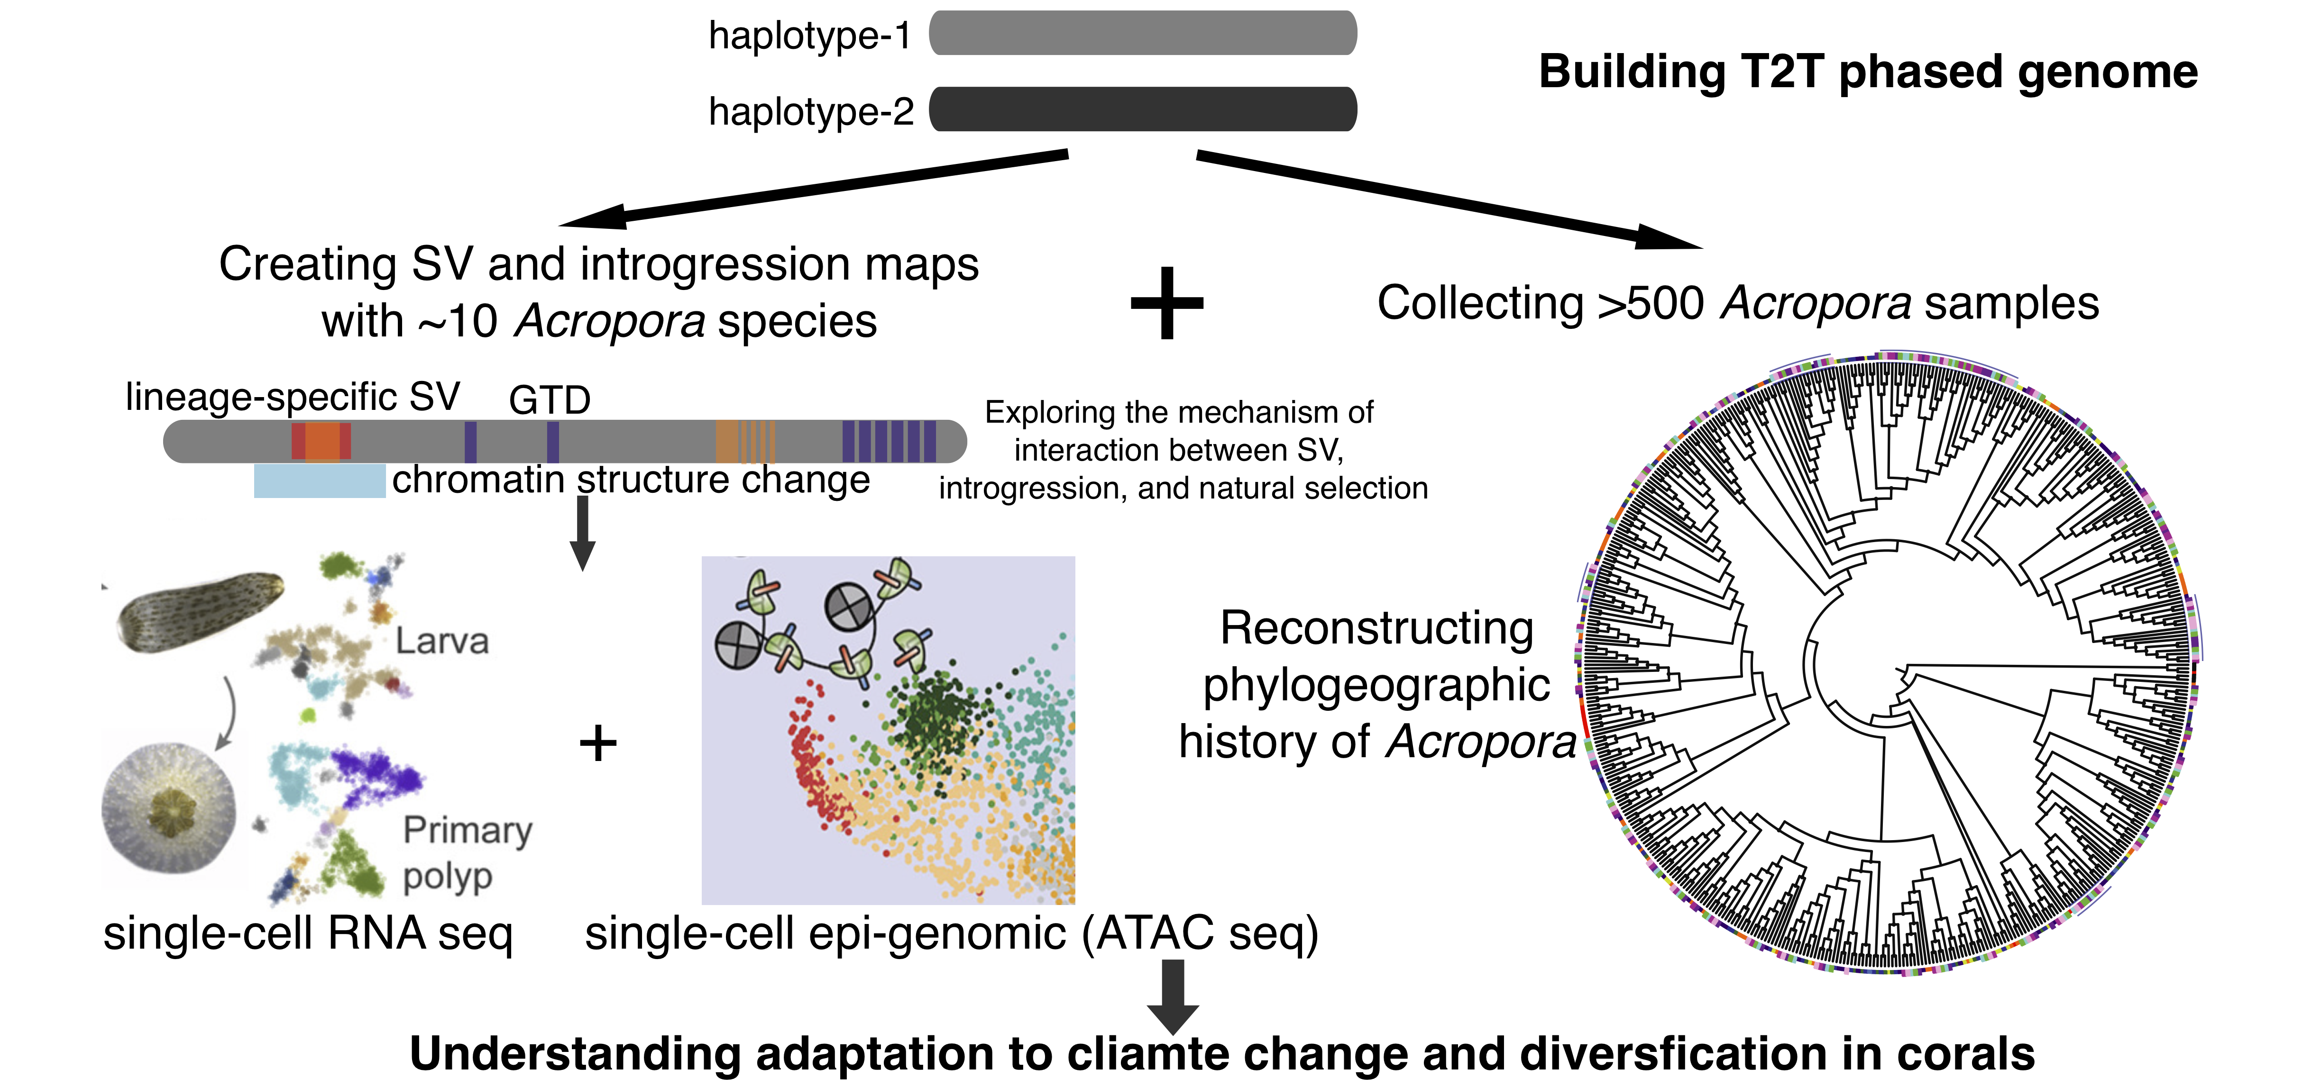
Summary
Aim 1
Aim 2
Aim 3
Significance:
1. comprehensive understanding of Acropora genomic diversity
2. revealing the origins and diversification of Acropora
3. understanding the genetic basis in association with adaptation
Coral conservation
General evolutionary theory

Slide 15
Long-term goal
identify and functionally characterize the effects of SVs, introgression, ILS, ecological factors, and selection with long-read technologies in speciation, adaptation, and diversification of reef-building corals and primates.

Slide 16

Thank you!

